Slide 1
MAP Testing Directions
Kim Luyster

Slide 2
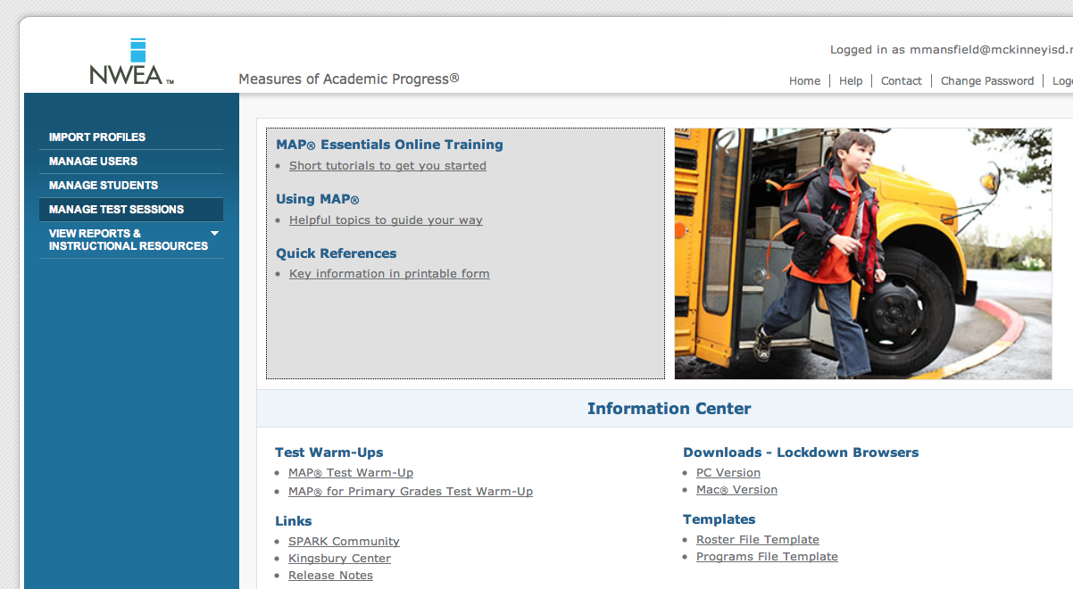
Click on Manage Testing Sessions

Slide 3
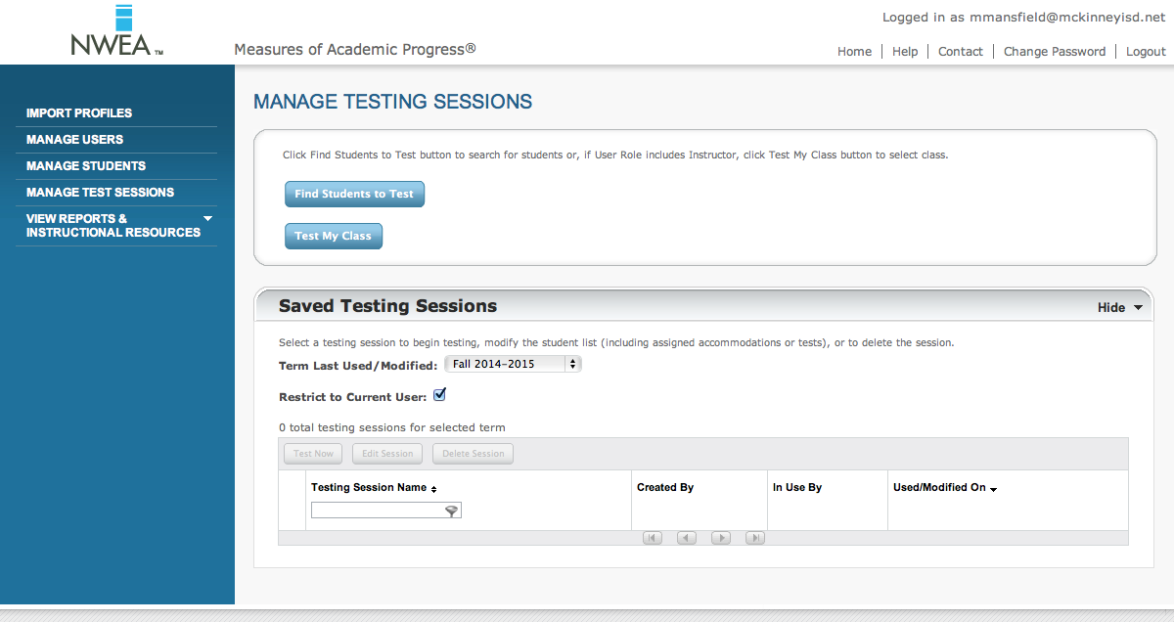
Uncheck the box titled “Restricted to Current User”

Slide 4
When you uncheck the box, you will be able to view all saved testing sessions.

Slide 5
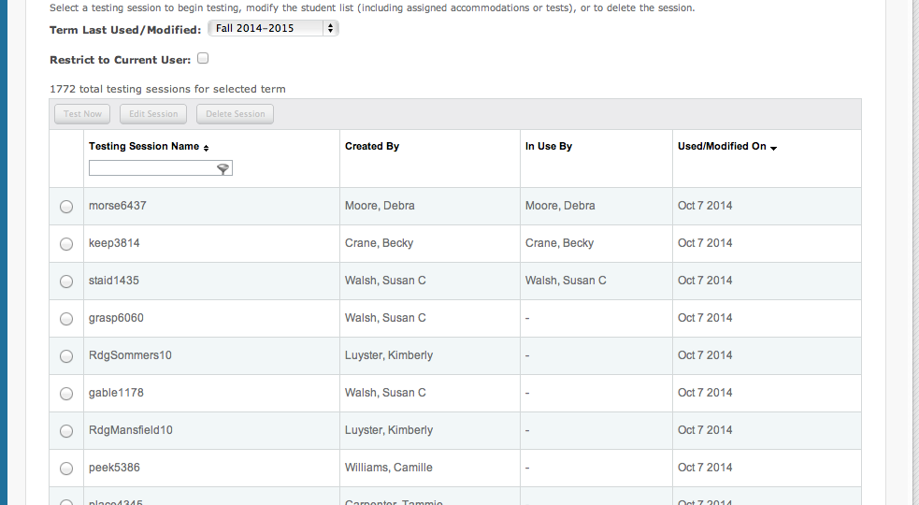
Under Testing session Name, type Rdg & search for your name, click on circle next to your name to select your testing session.

Slide 6
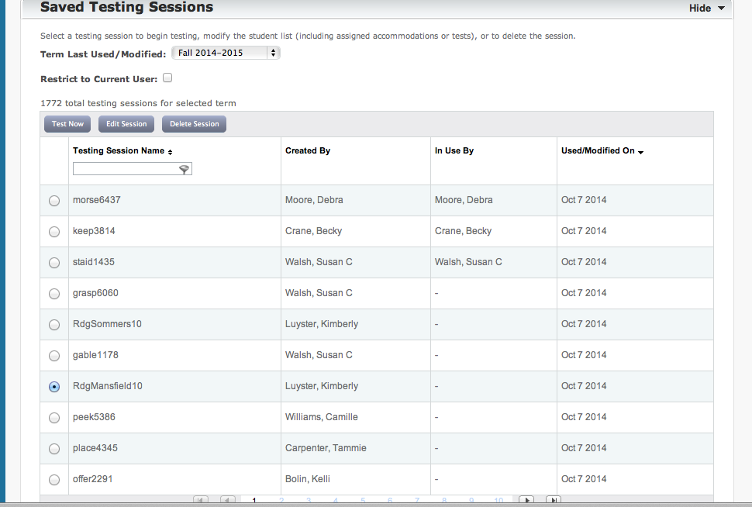
Once you select your name, click on button that says, “Test Now”

Slide 7
Test Now button is located at top of page.

Slide 8
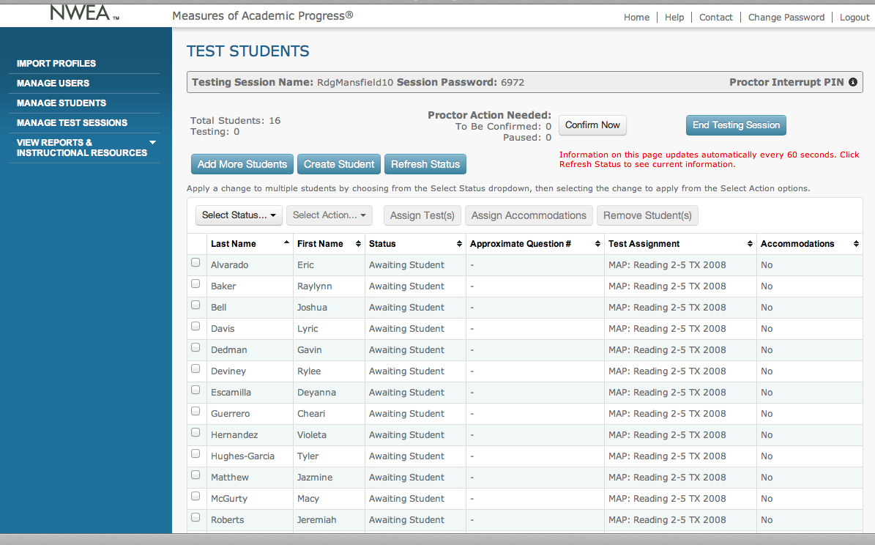
You can now view the session password at the top, this is the password that students use to log in.

Slide 9
Testing session name and password are located at the top of the page.

Slide 10
Testing Directions and Instructions for students were placed in your mailbox today, copies will also be in the computer lab and library. Kim L. & Susan H. will be there to assist you. No Worries! ☺
Be sure to look at the weebly that Susan created, and review your notes I put in your mailbox prior to testing.
Don’t forget to show your students the MAP video before testing. (link to video is on weebly)

